Slide 1
COVID VIRUS ANALYSIS
Done By:
Yashwanth K
Nov DA & DS

Slide 2


COVID VIRUS ANALYSIS
Done By:
Yashwanth K
Nov DA & DS

Slide 3
PROJECT DESCRIPTON
Objective:
This project analyzes COVID-19 cases globally using Excel for data cleaning and Power BI for visualizations.
It presents interactive dashboards showing confirmed cases, deaths, and recoveries across countries, helping to understand the pandemic's impact.

Slide 4
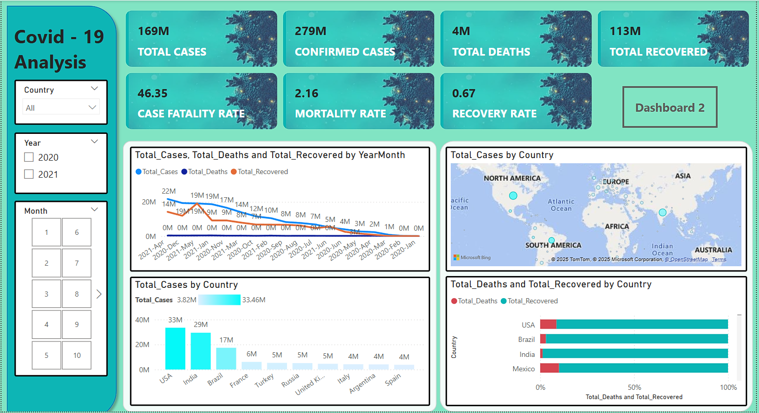
DASHBOARD

Slide 5
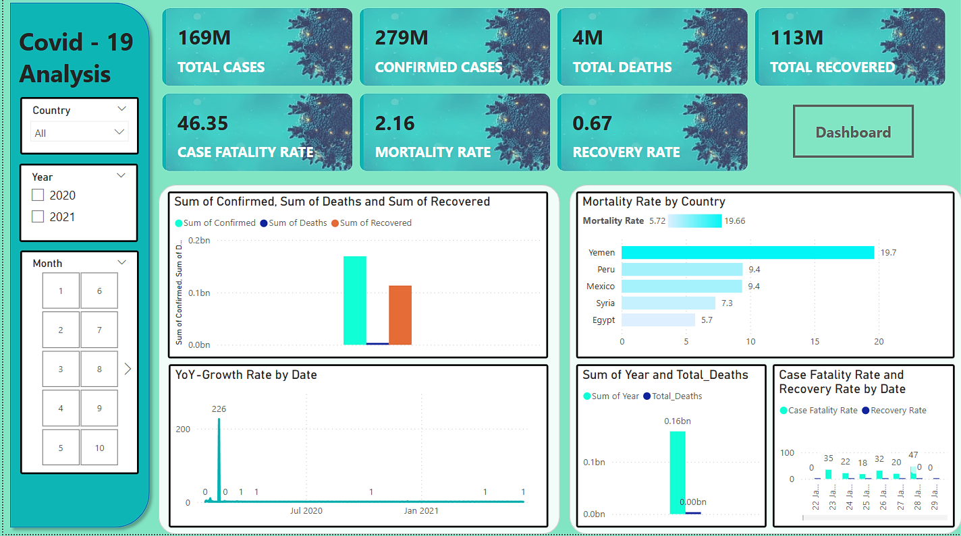
DASHBOARD 2

Slide 6
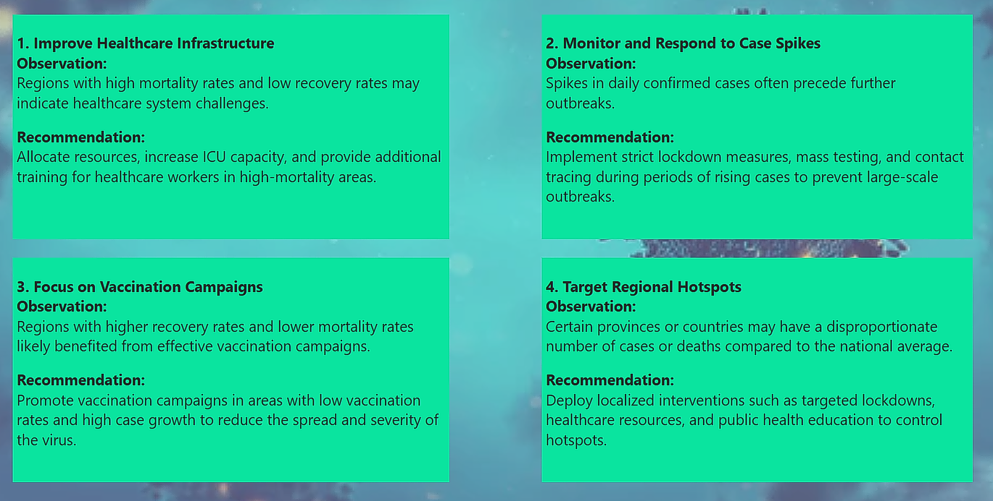
INSIGHTS & CONCLUSION

Slide 7


